Slide 1
NUMERICAL INTEGRATION
Presented By:
Shakeeb Hussain Siddiqui (k164043)
Mehdi Raza Rajani (k163904)
Saad Ismail (k164060)
Daniyal Raza Khawaja (k163952)

Slide 2
What is Integration?
Generally Integration is defined as:
“An act or instance of combining into an integral whole.”
Mathematically Integration is defined as:
“The operation of finding the integral of a function or equation,especially solving a differential equation.”
Two Types of Integration:
Analytical Integration
Numerical Integration

Slide 3
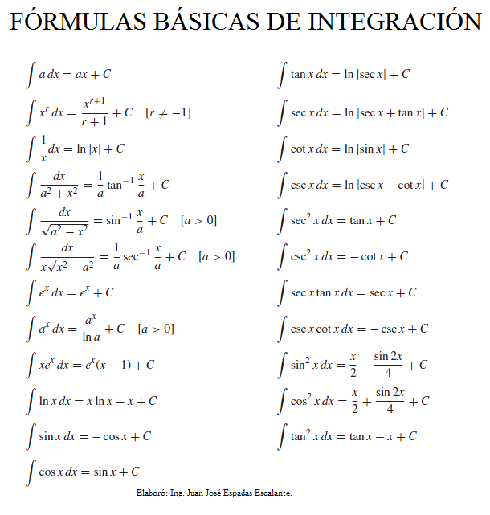
Analytical Integration
The Integration is done using the formulas among them few are following:

Slide 4


Try to Integrate the following function
We can not solve these using Analytical Technique.
So we move towards NUMERICAL INTEGRATION which give the approximate value but works almost all the time.

Slide 5
Numerical Integration
In numerical analysis, numerical integration constitutes a broad family of algorithms for calculating the numerical value of a definite integral, and by extension, the term is also sometimes used to describe the numerical solution of differential equations. The basic problem considered by numerical integration is to compute an approximate solution to a definite integral. It is different from analytical integration in two ways: first it is an approximation and will not yield an exact answer; Error analysis is a very important aspect in numerical integration. Second it does not produce an elementary function with which to determine the area given any arbitrary bounds; it only produces a numerical value representing an approximation of area.

Slide 6
History of Numerical Integration
The beginnings of numerical integration have its roots in antiquity.
Greek quadrature of the circle by means of inscribed and circumscribed regular polygons.
Sum of an infinitesimal area over a finite range.
Newton Formalized the concept of Numerical Integration:
This process broken down was taking a known area and overlapping it with an unknown area to approximate the area of the unknown shape. One could improve accuracy by choosing a better fitting shape. Later methods decided to improve upon estimating area under a curve decided to use more polygons but smaller in area. Such an example is the use of rectangles evenly spaced under a curve to estimate the area.

Slide 7
Types of Numerical Integration
There are a lot of different types of Numerical Integration, here are few of those:
Gaussian quadrature
Clenshaw–Curtis quadrature
Newton Cotes formulas
Though in this context we are only going to discuss Newton Cotes formulas.

Slide 8
Limitations of Newton Cotes formulas
Newton Cotes formulas have a limitation that it can only be applied for equally spaced data points. If we have already calculated data with unequal spaces between those then Newton Cotes formulas can not be used.
There are two variations of Newton-Cotes formulas:
Closed Newton-Cotes formulas: When extreme points are also used to approximate the integral.
Open Newton-Cotes formulas: When extreme points are not used to approximate the integral.
The approximation gets better when we add more data points.

Slide 9

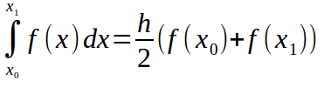



Closed Newton Cotes Formulas
Trapezoidal Rule ( n = 1 ):
Simpson 3/8 Rule ( n = 3 ):
Simpson 1/3 Rule ( n = 2 ):
Boole’s Rule ( n = 4 ):

Slide 10

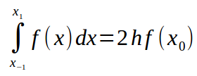



Open Newton Cotes Formulas
MidPoint Rule ( n = 0 ):
( n = 2 ):
( n = 1 ):
( n = 3 ):

Slide 11

Any Questions ???
Thanks For Listening Us !!!

